Slide 1

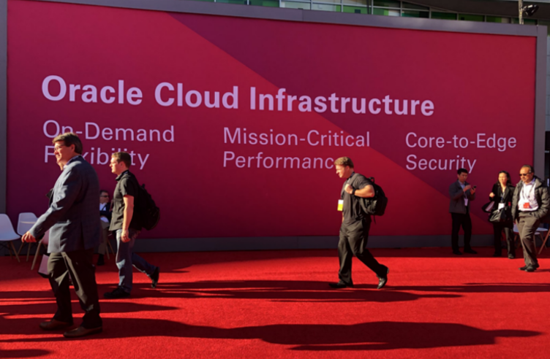
Oracle OpenWorld & CodeOne Review Pillar One Oracle Cloud Infrastructure
Oracle Cloud Infrastructure aka OCI
2nd Generation Cloud
Notes:
Fast data arrives in real time and potentially high volume. Rapid processing, filtering and aggregation is required to ensure timely reaction and actual information in user interfaces. Doing so is a challenge, make this happen in a scalable and reliable fashion is even more interesting. This session introduces Apache Kafka as the scalable event bus that takes care of the events as they flow in and Kafka Streams and KSQL for the streaming analytics. Both Java and Node applications are demonstrated that interact with Kafka and leverage Server Sent Events and WebSocket channels to update the Web UI in real time. User activity performed by the audience in the Web UI is processed by the Kafka powered back end and results in live updates on all clients.
Fast data arrives in real time and potentially high volume. Rapid processing, filtering and aggregation is required to ensure timely reaction and actual information in user interfaces. Doing so is a challenge, make this happen in a scalable and reliable fashion is even more interesting. This session introduces Apache Kafka as the scalable event bus that takes care of the events as they flow in and Kafka Streams for the streaming analytics. Both Java and Node applications are demonstrated that interact with Kafka and leverage Server Sent Events and WebSocket channels to update the Web UI in real time. User activity performed by the audience in the Web UI is processed by the Kafka powered back end and results in live updates on all clients. Introducing the challenge: fast data, scalable and decoupled event handling, streaming analytics Introduction of Kafka demo of Producing to and consuming from Kafka in Java and Nodejs clients Intro Kafka Stream API for streaming analytics Demo streaming analytics from java client Intro of web ui: HTML 5, WebSocket channel and SSE listener Demo of Push from server to Web UI - in general End to end flow: - IFTTT picks up Tweets and pushed them to an API that hands them to Kafka Topic. - The Java application Consumes these events, performs Streaming Analytics (grouped by hashtag and author and time window) and counts them; the aggregation results are produced to Kafka - The NodeJS application consumes these aggregation results and pushes them to Web UI - The WebUI displays the selected Tweets along with the aggregation results - in the Web UI, users can LIKE and RATE the tweets; each like or rating is sent to the server and produced to Kafka; these events are processed too through Stream Analytics and result in updated Like counts and Average Rating results; these are then pushed to all clients; this means that the audience can Tweet, see the tweet appear in the web ui on their own device, rate & like and see the ratings and like count update in real time

Slide 2

Oracle Cloud Infrastructure:
Highest, Most Consistent
Performance
Low, Predictable Pricing
Enterprise Workload Migration
a true enterprise cloud

Slide 3
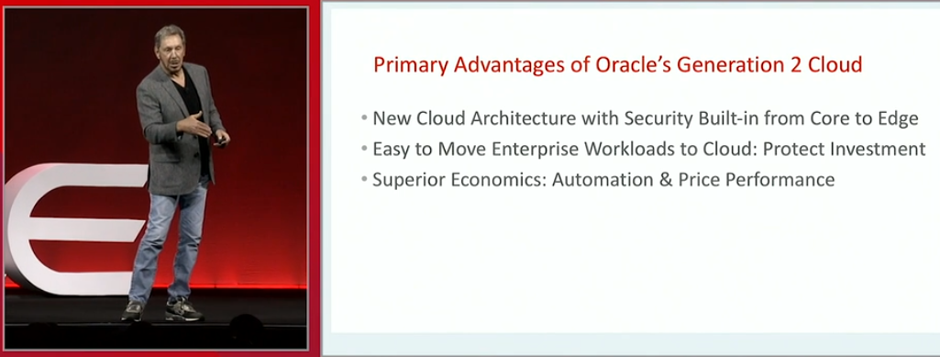
Gen 2 Cloud

Slide 4

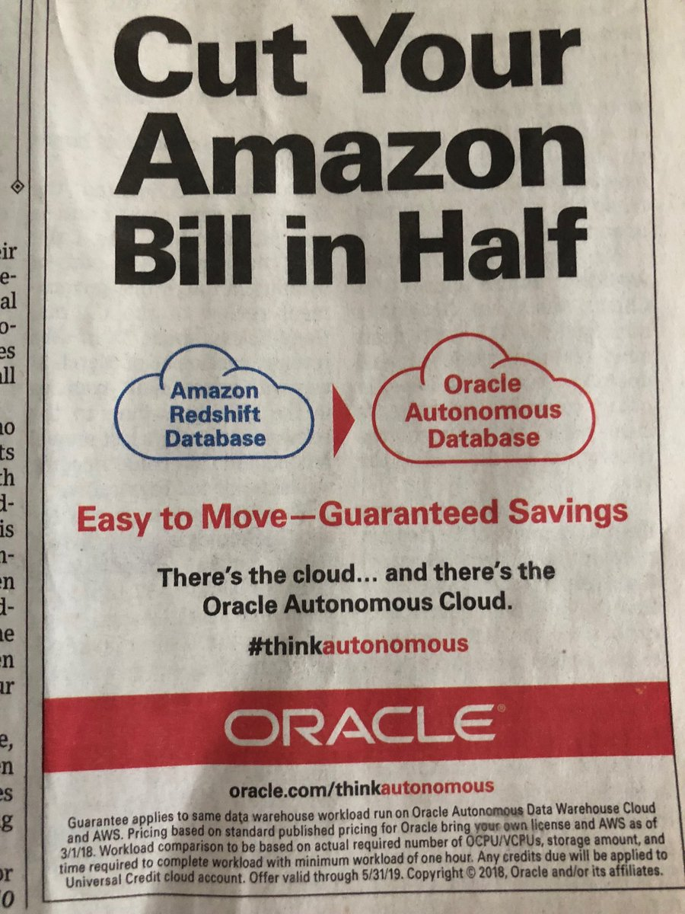
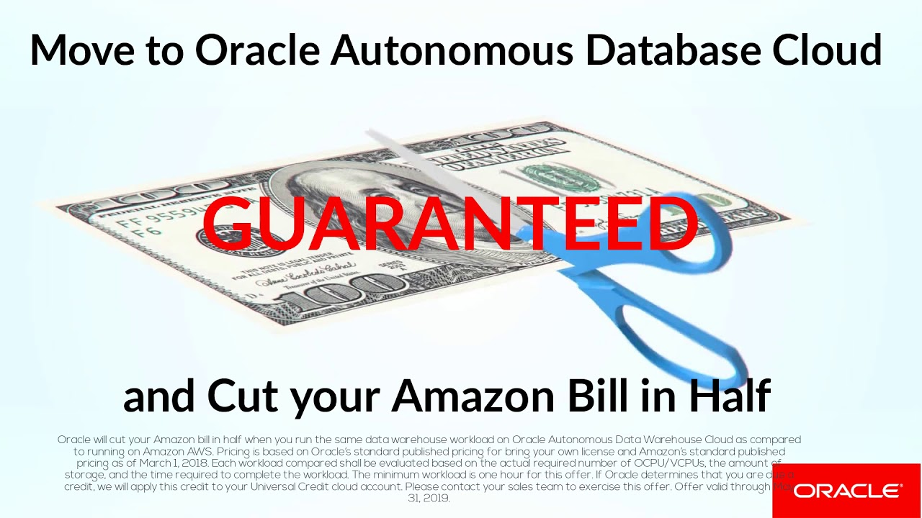
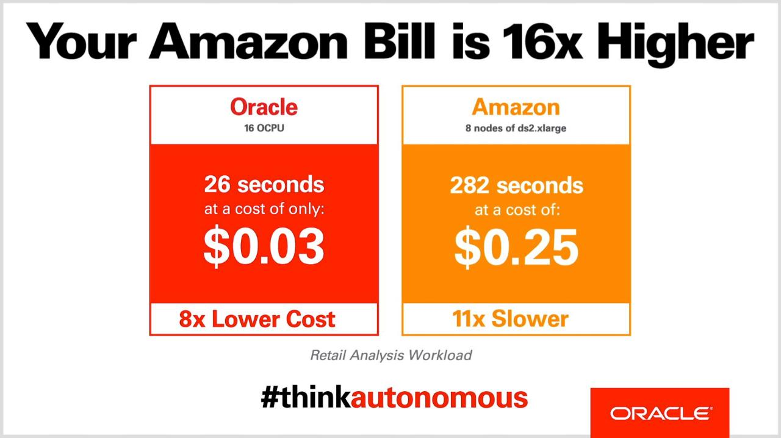

Slide 5
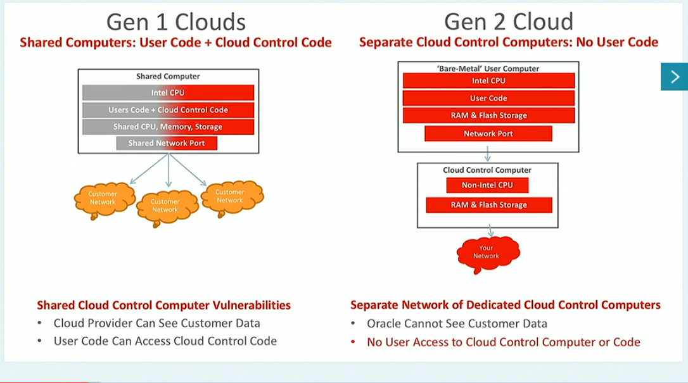
Oracle Cloud Built for High Performance and Security
Notes:
Core acritical choices are optimized for Security and Performance.
Our physical network design is flat and non-oversubscribed.
Our secret saus is off box virutalzoation; As name suggests implemented Storage and Networking virutaizont is built out side server (unlike other clouds everything is on the hypervisor). It has two advantages a) No provider SW runs on your machine. Hence secure. And b) We can offer you bare metal server on-demand.

Slide 6
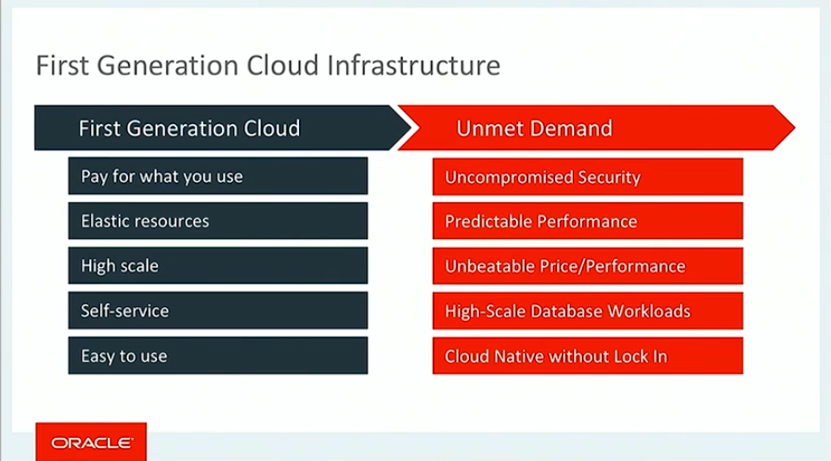
First Generation Cloud Vendors…vs Gen 2

Slide 7
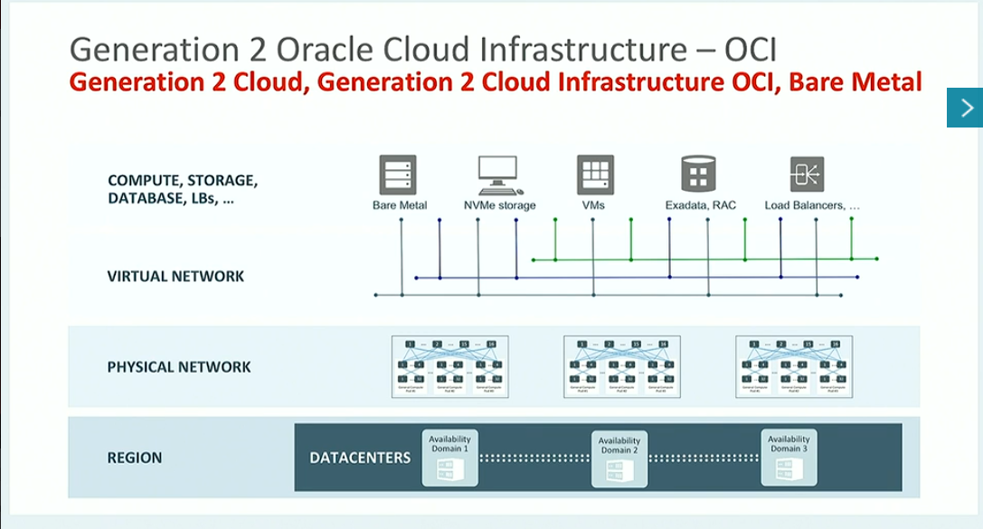

Slide 8
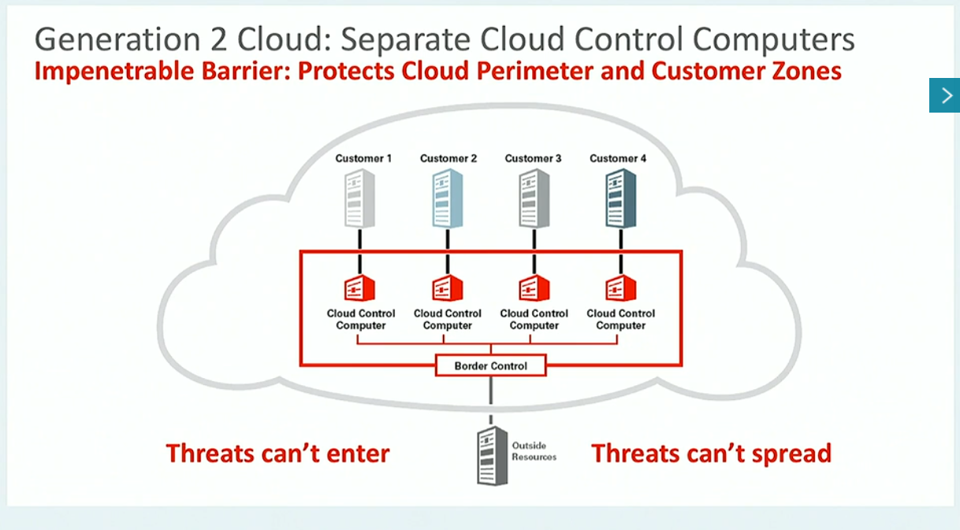

Slide 9
The Latest Technologies Enable a Modern Cloud Infrastructure
Technology | Benefit
Availability domains, Fault domains | Enterprise-level resiliency
No oversubscription, flat non-blocking architecture | Low latency between resources, predictable performance, eliminates “noisy neighbor issues”
Off-box IO virtualization | Better security through management isolation, better performance through IO management offload from server CPU
NVMe SSD storage everywhere | Millions of IOPS for workloads that need them

Slide 10


Oracle Cloud Infrastructure: Complete Services
COMPUTE
Bare metal/VM, CPUs/GPUs
STORAGE
NVMe, Block, File, Object, Archive
AUTONOMOUS DATABASE
Transactions, Data Warehouse
SECURITY
IAM, Audit, KMS, CASB
Up to: 52 CPU cores, 8 GPUs, 768 GB RAM, 51 TB local SSD, 5M IOPS
Predictable IOPS Block Storage for up to 98% less, storage for whole lifecycle
Fast provisioning. Automatic tuning, patching, securing. 99.995% availability.
Integrated security services to protect data and to control and monitor access
CONTAINERS
Containers and Kubernetes
NETWORKING
VCN, LBaaS, FastConnect, VPN
DATABASE
VM, Bare metal, Exadata
EDGE
DNS, WAF, DDoS, Email
Fully managed, certified Kubernetes service with Docker containers
Isolated networks with reserved IPs, security lists, firewalls, lowest cost private connectivity
Massive performance & scale; RAC and Active Data Guard support
Global DNS, application protection, bot management, DDoS protection, email delivery
RAVELLO
Migrate VMware or KVM
CLOUD AT CUSTOMER
Exadata, Big Data
DATA MOVEMENT
Storage Gateway, Data Transfer
GOVERNANCE
Compartments, Tagging
Move VM environments to managed cloud service, retain existing networking
On-premises cloud infrastructure / analytics / Exadata service, managed by Oracle, pay as you go
File to object cloud Storage Gateway, Data Transfer Appliance for large scale ingest
Logical separation and tagging of resources for simplified management

Slide 11
Pillar 1: OCI
Self confidence within Oracle
All PaaS have to be on OCI within three months
Those that are not, may not have a future
Competing on performance and price
Get the job done rapidly (analysis, real time decision/evaluation where straight processing time is) very important and time-bound
Total price is much lower: $ = Resources * Time running * price/resource/time

Slide 12


Hardware and Software still break in the cloud!

Slide 13
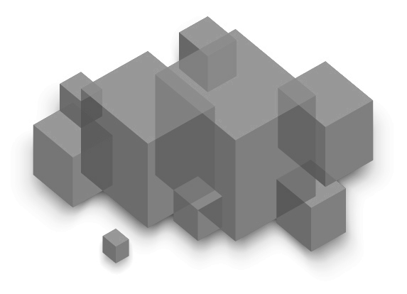
Availability Domains
Availability Domain 1
Regional Model
Sub-millisecond latency between ADs
10Gb/sec between each instance in different ADs
Guaranteed anti-affinity
Staged updates/maintenance
Availability Domain 2
Availability Domain 3
Best Practice:
Distribute app tier nodes across availability domains

Slide 14
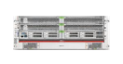
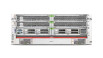
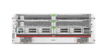
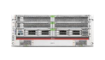
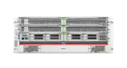
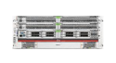
Regions
Regions serve different geographies, provide disaster recovery
Phoenix, AZ; Ashburn, VA; Frankfurt, DE; London, UK. More to come!
Region
Region
Availability Domain 1
Availability Domain 1
Availability Domain 2
Availability Domain 3
Availability Domain 2
Availability Domain 3
Region
Availability Domain 1
Best Practice:
Create DR environments across regions
Availability Domain 2
Availability Domain 3
Very Low Latency, High Bandwidth
Network Between Regions
Notes:
High Availability architectures require fault isolated building blocks.
We provide 3 physically close but fault isolated Availability Domains within a Region, allowing for synchronous replication and constant uptime for almost any disaster.
Each Availability Domain is an Independent data center, with independent power and network.
Multiple Regions with a high bandwidth network and easy connectivity to support recovery for truly catastrophic events.

Slide 15
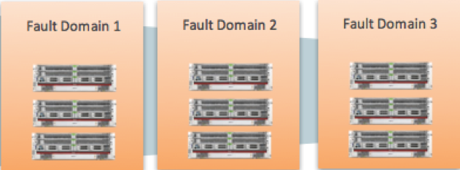
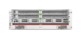
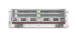
Fault Domains
Fault domain is a logical grouping of hardware and infrastructure within an Availability Domain
Provides a higher degree of protection from unexpected hardware failures or compute hardware maintenance
Each Availability Domain has 3 Fault Domains.
You can optionally select a FD when creating an instance. Otherwise OCI will select a FD in that AD
Fault Domains are supported for both BM and VM instances in all regions.
OCI will place each instance of a RAC database in a separate FD.
Region
Availbility Domain 1
Availability Domain 2
Availability Domain 3

Slide 16









Oracle Offers a Comprehensive Set of Cloud Services
Partner Ecosystem
Dev Ops
Big Data & Analytics
Container Ecosystem
Oracle on Oracle
Tooling
Dev Tools
Deployment
Hadoop / Spark
Kafka
Visualization
Data Integration / ETL
Java Cloud Service
Integration Cloud Service
Migration / Hybrid
Identity (AD, SSO, LDAP)
VM Migration
DB Migration
Container Registry
Kubernetes
Serverless / FaaS
SOA CS
API Management
Next Layer Services
Caching
DBaaS
ATP
ADW
ExaCS
Database as a Service
Exadata Cloud Service
Autonomous Data Warehouse
Autonomous Transaction Processor
Oracle Caching Service
Data Services
Compute
Bare Metal
Virtual Machines
Storage
Block
Object
Networking
VCN
Load Balancer (LBaaS)
GPU shapes
High frequency CPUs
Object Archive
File
Storage Gateway
Service Gateway
FastConnect
Content Delivery Network (CDN)
DNS
Security
Key Management Service (KMS)
Policy
Identity
CASB
SIEM
WAF
DDoS
Governance and Management
Monitoring & Logging
Audit & Events
Credential Manager
Secret Manager
Cost Management
Compartments & Tags
Import Appliance
Core Services
Notes:
Eye chart ..
For the last four year, we have been budilgin ..
Core service …
Data services ..
Next laryer services ...to help deploy your applciations faster.
And a vibrant third party ecosystem
Key takeaway – If you have an pplication that neds to be deployed in the cloud, we can do it the way you want to.

Slide 17
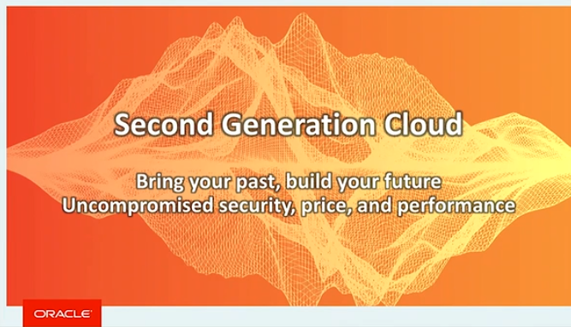

Slide 18
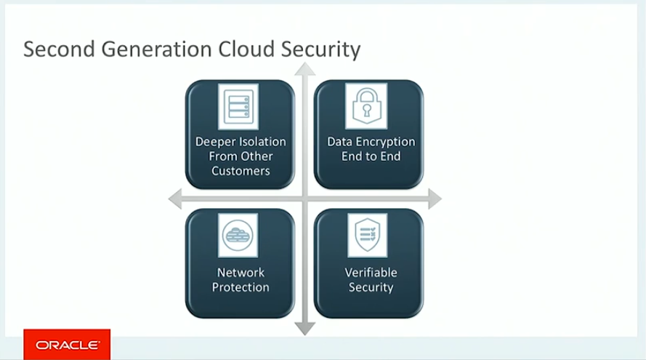
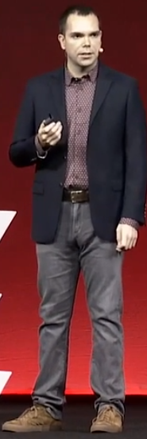
Clay Magouyrk, Senior Vice President, Software Development, Oracle
Notes:
Clay Magouyrk, Senior Vice President, Software Development, Oracle

Slide 19
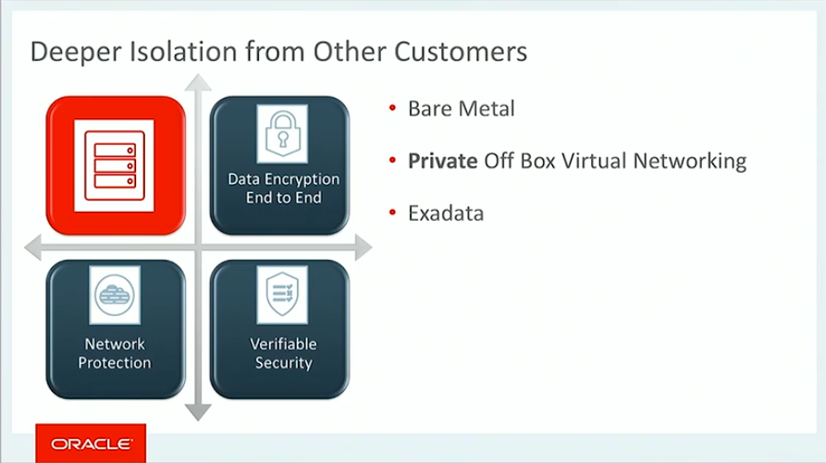

Slide 20
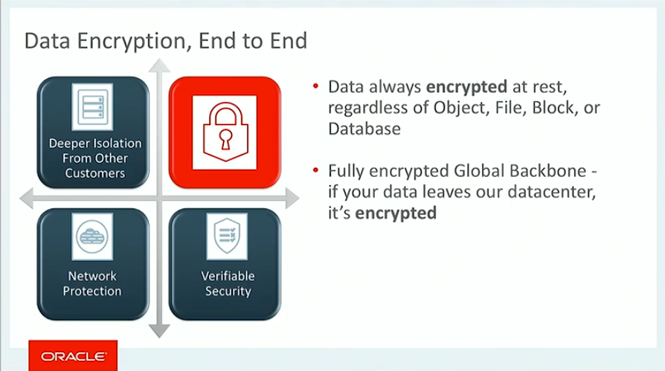

Slide 21
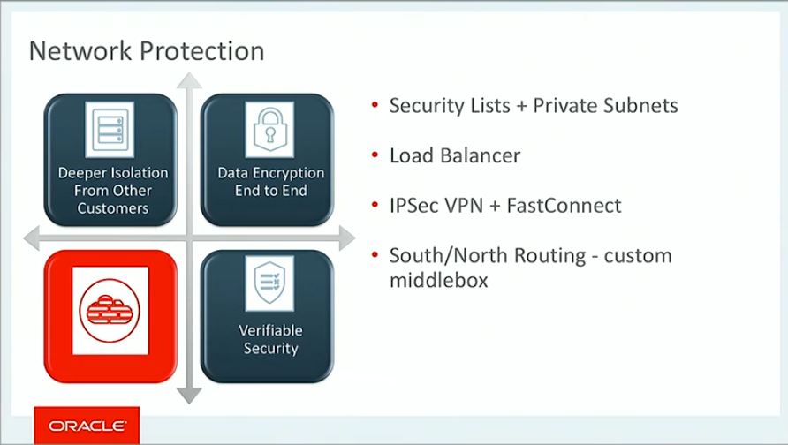

Slide 22
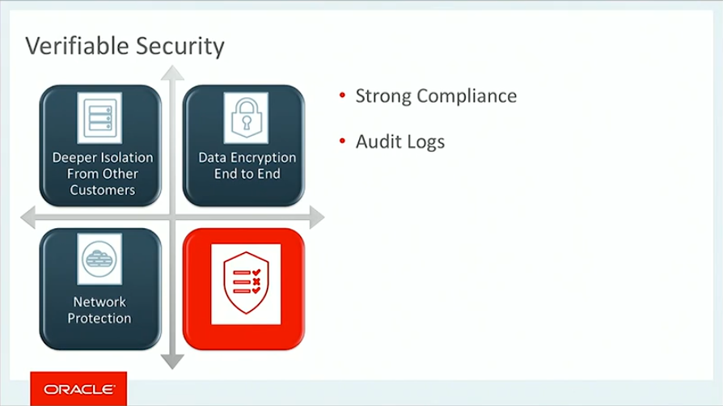

Slide 23
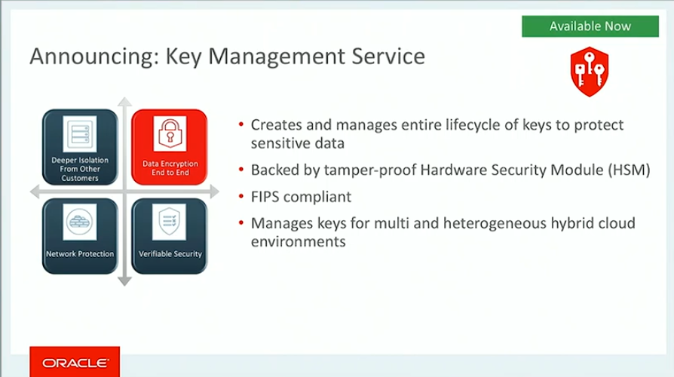

Slide 24
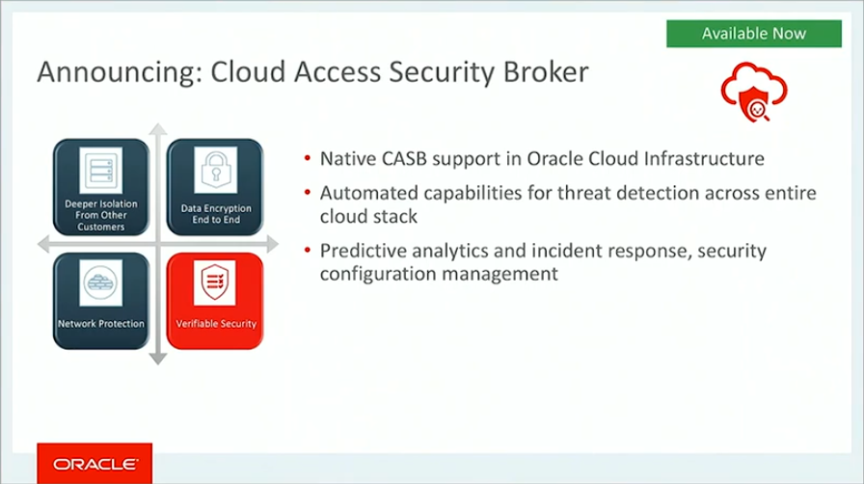

Slide 25
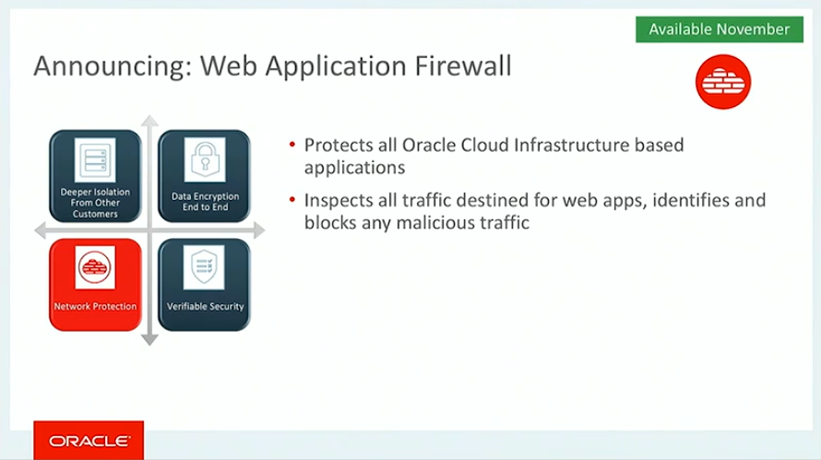

Slide 26
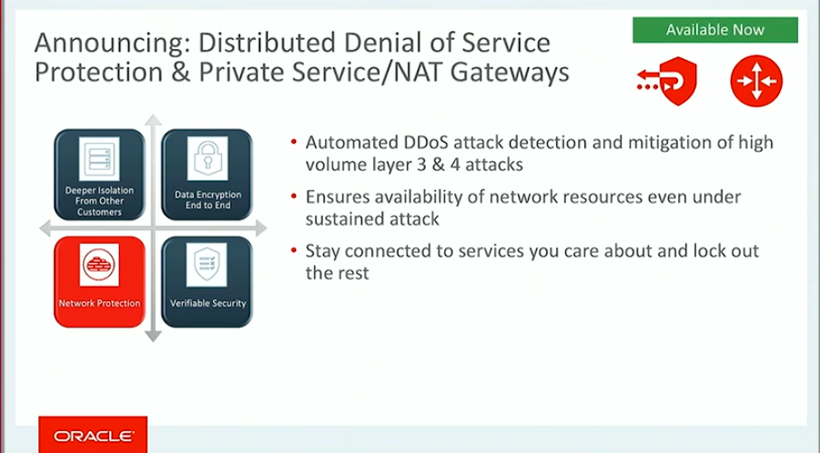

Slide 27
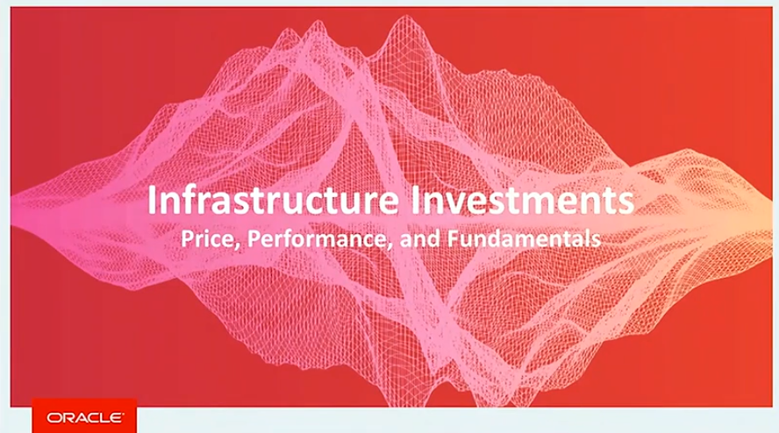

Slide 28
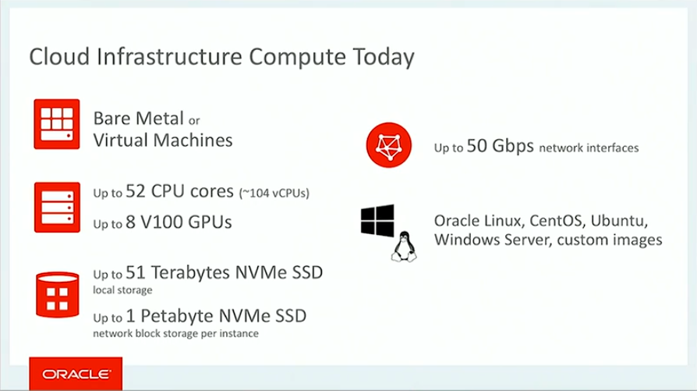

Slide 29
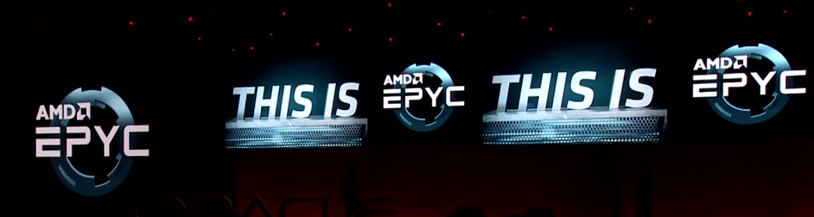
AMD’s new high performance CPU

Slide 30
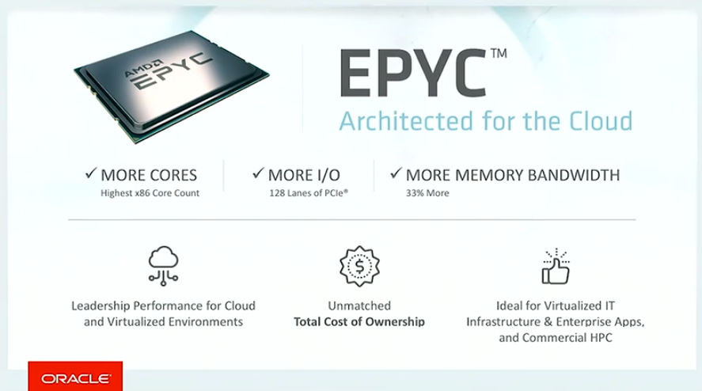
OCI adopts AMD EPYC – as the first cloud provider

Slide 31
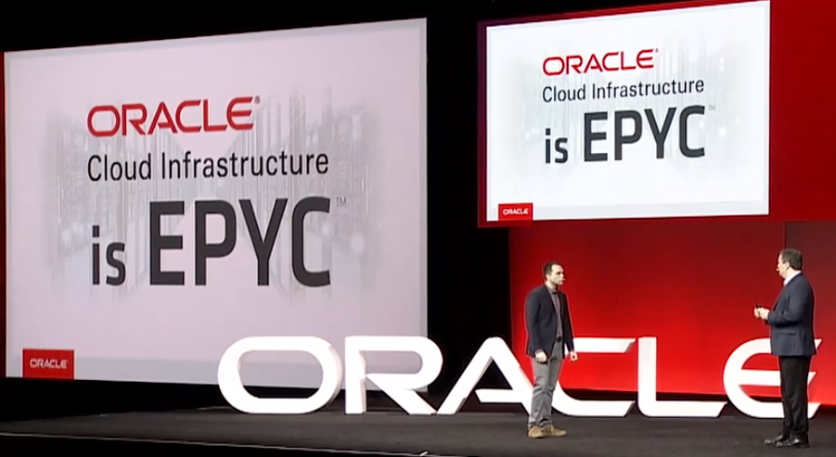

Slide 32
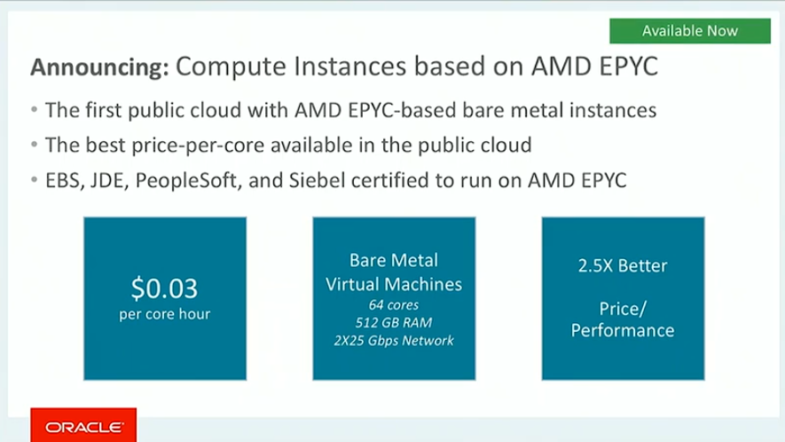

Slide 33
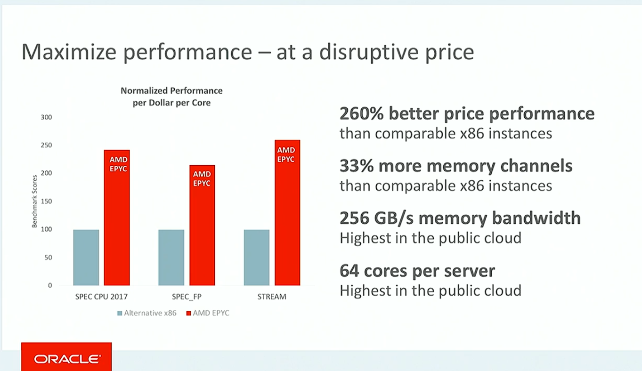

Slide 34
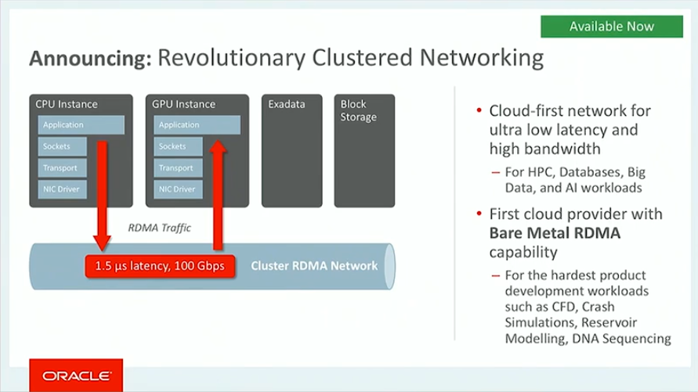

Slide 35
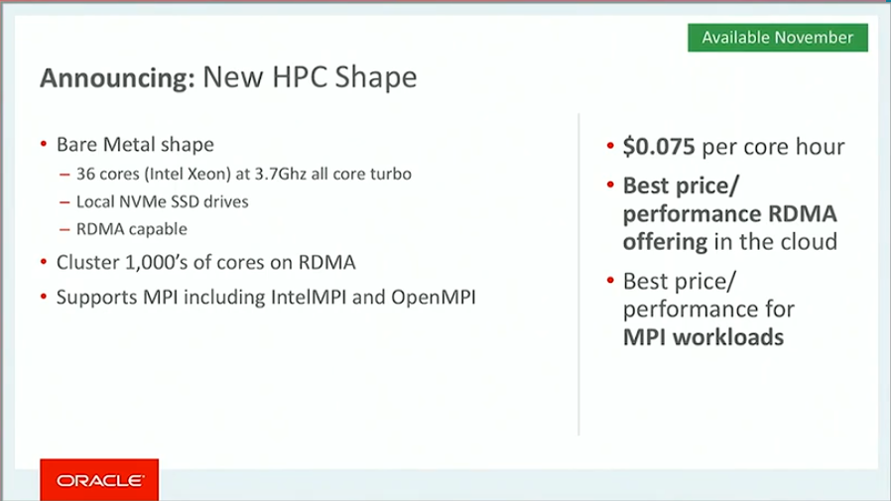
High Performance Compute Shape [for serious workloads]

Slide 36
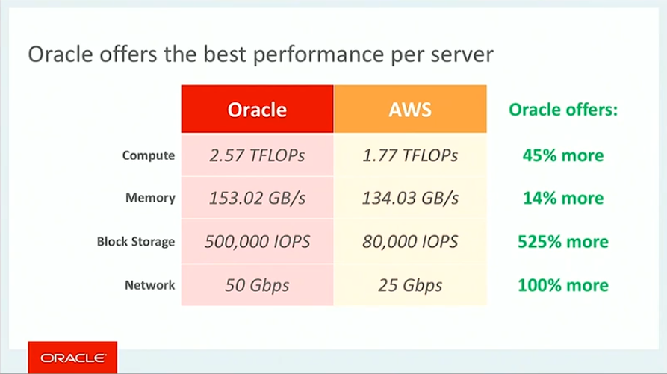
If you need peak performance…

Slide 37
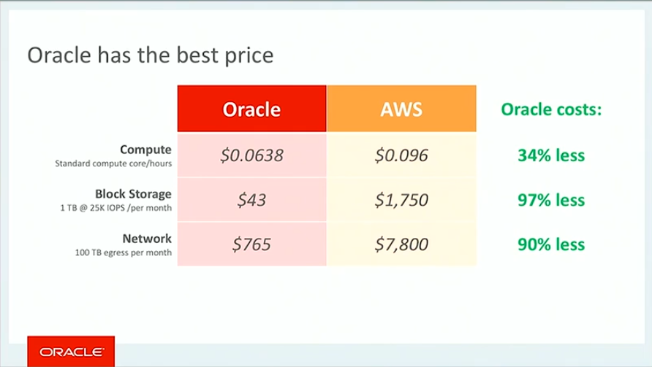
Peak performance means short/less usage – usage * price/usage => Bill

Slide 38
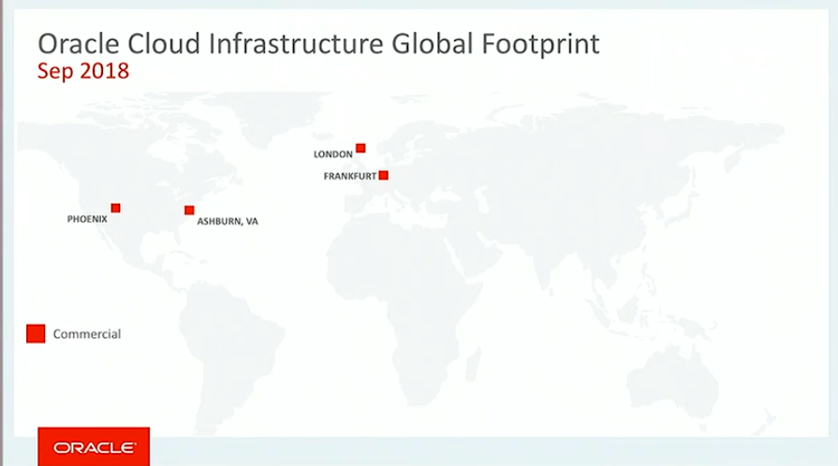
Current footprint of OCI enabled data centers

Slide 39
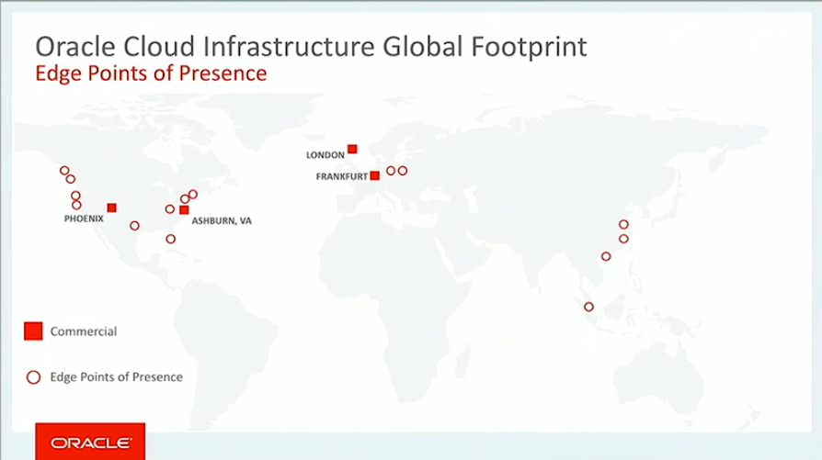
Edge connectivity, DNS, Web Security

Slide 40
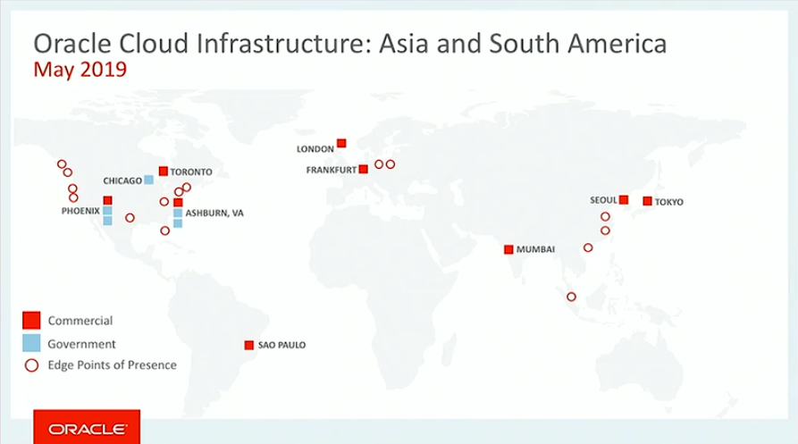
Rollout of Data Centers – status May 2019

Slide 41
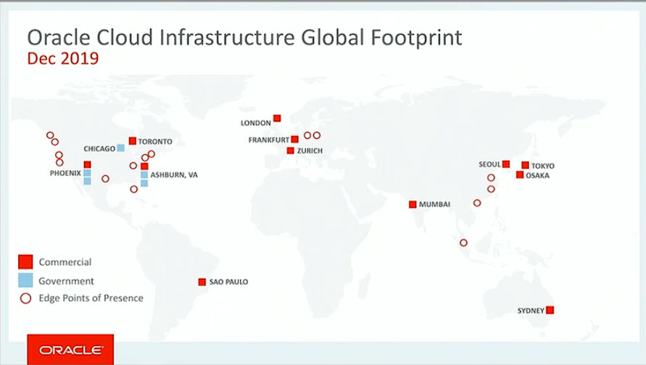
Global Footprint of Oracle Cloud Infrastructure - End of 2019

Slide 42
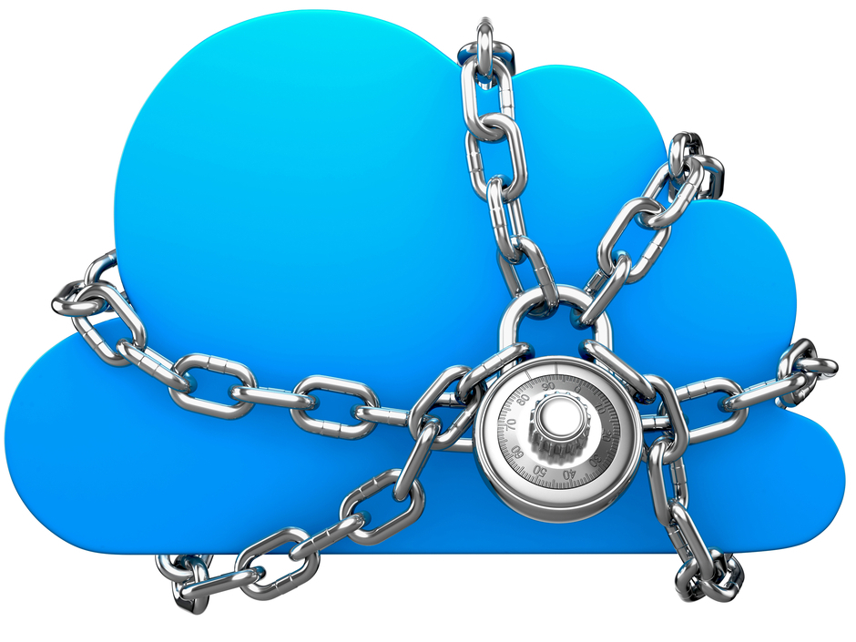
Cloud Outer Security Perimeter
SECURITY
IAM, Audit, KMS, CASB
Integrated security services to protect data and to control and monitor access
EDGE
DNS, WAF, DDoS, Email
Global DNS, application protection, bot management, DDoS protection, email delivery

Slide 43
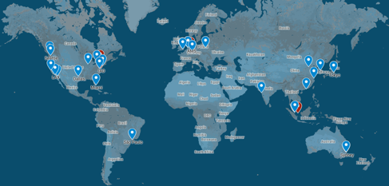
The Oracle Cloud Infrastructure Edge Network Edge Points of Presence – Gateways into OCI
Notes:
The cloud edge is the point where people and devices connect to the network, making it both a crucial point for users’ interactions with applications in the cloud and a potential launch point for attacks. Our cloud edge is mature, proven, and fully scaled. The Oracle Cloud Infrastructure edge network is built to deliver the following advantages in a multicloud environment:
Ensure high-speed web traffic with minimal latency
Defend against targeted application-layer attacks
Protect against volumetric attacks on network infrastructure
https://blogs.oracle.com/cloud-infrastructure/oracle-cloud-infrastructure-is-ready-for-any-and-all-workloads

Slide 44
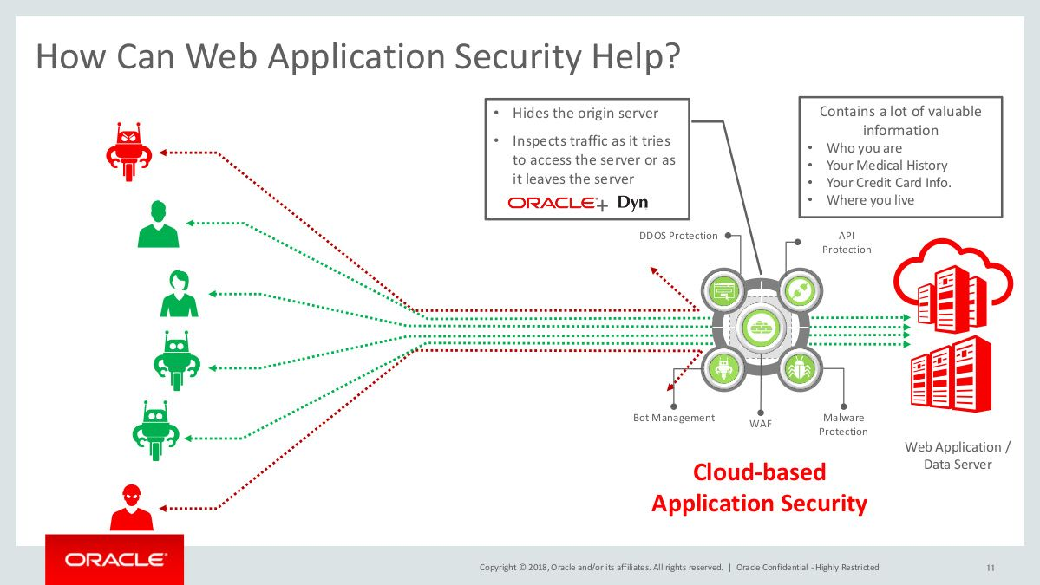

Slide 45
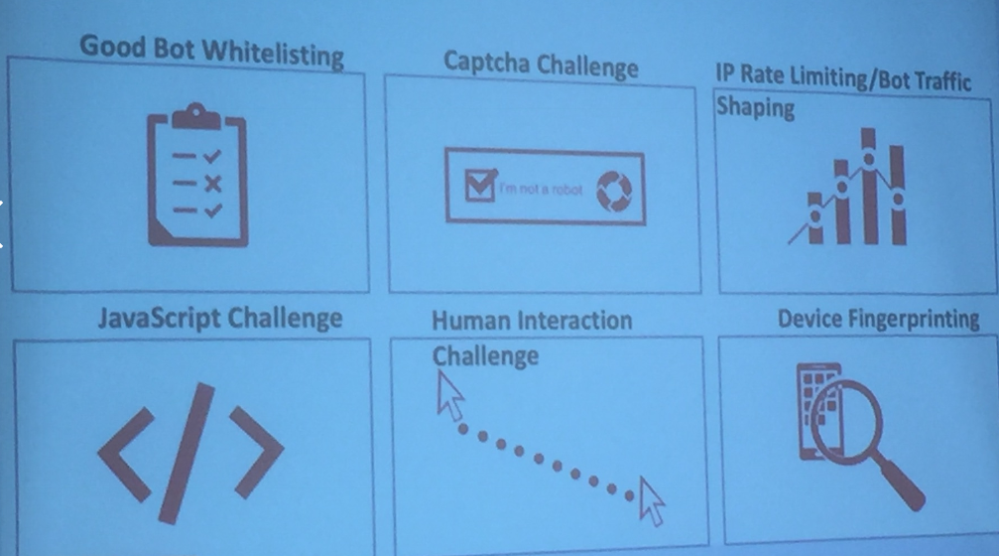
Intercept malicious traffic at Edge Point of Presence

Slide 46
Edge network
32 edge locations across the world
Outside OCI regions
Accept requests to Web Applications, APIs and other endpoints exposed by an organization
Whether the endpoint is in OCI, on premises or in 3rd party cloud
Request is inspected and evaluated: is it an attack, a bad bot, or a regular request
If considered a threat – not passed on to real endpoint
Used advanced strategies like ‘mouse was not moved in client prior to click’
Similar to API Gateway – but layer around it to protect the API Gateway
OCI Web App Security – has dozens of ‘internet sensors’ to constantly monitor internet traffic around the world and the accessibility | availability | response time of many web sites
Check out internetintelligence.oracle.com

Slide 47
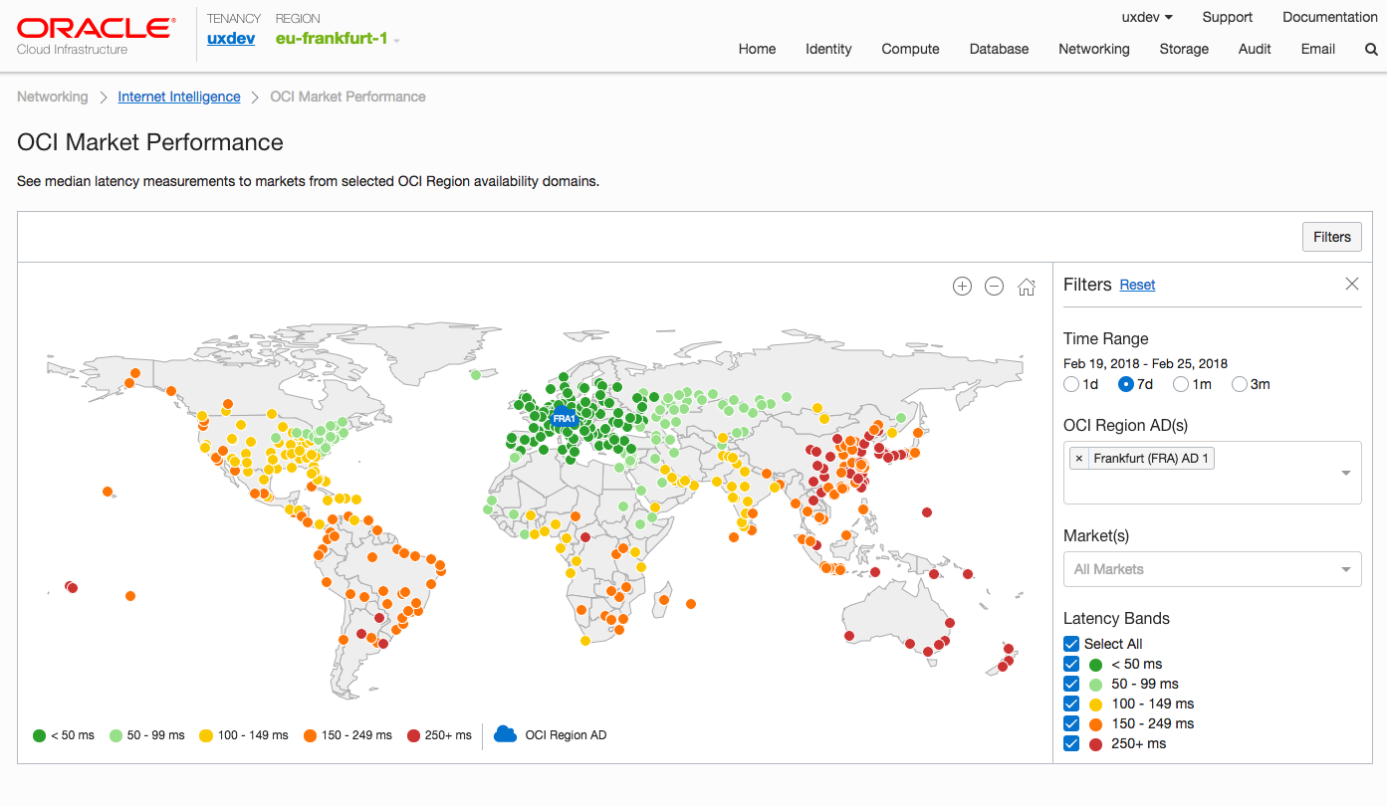
Global Network of Internet Sensors

Slide 48

map.internetintel.oracle.com
Notes:
https://map.internetintel.oracle.com/

Slide 49

Internetional Studies
Iraq blocks internet nationally to prevent students from cheating
Notes:
https://twitter.com/InternetIntel

Slide 50

OCI Security Services
Oracle Cloud Infrastructure Key Management provides centralized management of the encryption of your data
Manage master and data keys used for encryption of data in Object and Block Storage on OCI
Keys are stored on highly available and durable hardware security modules (HSM) that meet Federal Information Processing Standards (FIPS) 140-2 Security Level 3 security certification

Slide 51



Monitor the AMIS Technology Blog

Slide 52

Current accessibility status for AMIS Technology Blog

Slide 53

Same test for nu.nl

Slide 54


Slide 55


Slide 56


Slide 57


Slide 58


Slide 59


Slide 60


Slide 61

Cloud Native Applications on OCI
Notes:
https://www.oracle.com/openworld/on-demand.html?bcid=5853085984001
Time: 43:25

Slide 62


Slide 63



Slide 64


Slide 65


Slide 66


Slide 67


Slide 68


Slide 69


Slide 70


Slide 71


Slide 72


New OCI service offerings for Cloud Native Applications

